Slide 1
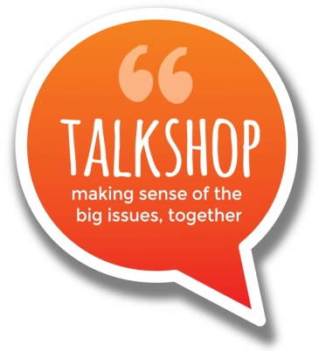
The Growing Spiral of Connected Political Conversations
a way to support, connect and act on many respectful discussions
CONVERSATION
Events held:
Regular venues
Discussion groups
One offs
Some involve facilitation
Everyone gets to talk
Respectful listening
Search for agreement
PREPARATION
Materials and different formats are prepared, e.g.:
Talk Shop - discussion kit
Thinking Box - video programme
SELECTION
An issue is chosen
In agreement with policy-makers
PEOPLE GROW in their belief of this new kind of democracy, and their demands for it
PEOPLE GROW in their understanding of how democracy might be, and their hunger for it
PEOPLE GROW in their grasp of the issue , how others see it, and in understanding how democracy might be.
COLLECTION
Results collected, collated and fed back
PUBLICATION
Results simplified and made accessible by e.g.
Argument mapping
Videos & Text
Turning them into a song
START HERE
ACTION
Decision taken and put into action
PRESENTATION
Results presented to policy-makers, councils, MPs, stakeholders etc.

